Slide 1
Check Out the New User Interface API
Craig Isakson, Technical Architect
craig.isakson@sundoginteractive.com, @craigisak

Slide 2

Forward-Looking Statement
Statement under the Private Securities Litigation Reform Act of 1995
This presentation may contain forward-looking statements that involve risks, uncertainties, and assumptions. If any such uncertainties materialize or if any of the assumptions proves incorrect, the results of salesforce.com, inc. could differ materially from the results expressed or implied by the forward-looking statements we make. All statements other than statements of historical fact could be deemed forward-looking, including any projections of product or service availability, subscriber growth, earnings, revenues, or other financial items and any statements regarding strategies or plans of management for future operations, statements of belief, any statements concerning new, planned, or upgraded services or technology developments and customer contracts or use of our services.
The risks and uncertainties referred to above include – but are not limited to – risks associated with developing and delivering new functionality for our service, new products and services, our new business model, our past operating losses, possible fluctuations in our operating results and rate of growth, interruptions or delays in our Web hosting, breach of our security measures, the outcome of any litigation, risks associated with completed and any possible mergers and acquisitions, the immature market in which we operate, our relatively limited operating history, our ability to expand, retain, and motivate our employees and manage our growth, new releases of our service and successful customer deployment, our limited history reselling non-salesforce.com products, and utilization and selling to larger enterprise customers. Further information on potential factors that could affect the financial results of salesforce.com, inc. is included in our annual report on Form 10-K for the most recent fiscal year and in our quarterly report on Form 10-Q for the most recent fiscal quarter. These documents and others containing important disclosures are available on the SEC Filings section of the Investor Information section of our Web site.
Any unreleased services or features referenced in this or other presentations, press releases or public statements are not currently available and may not be delivered on time or at all. Customers who purchase our services should make the purchase decisions based upon features that are currently available. Salesforce.com, inc. assumes no obligation and does not intend to update these forward-looking statements.
Notes:
Key Message Salesforce is a publicly traded company. Customers should make buying decisions only on the products commercially available.
Talk Track Before I begin, just a quick note that you should base your purchasing decisions on products and services that are currently available.

Slide 3

Slides
https://bit.ly/2CPHZ4j

Slide 4

Code
https://bit.ly/2x7JggS

Slide 5

User Interface API
What’s coming!
What is it?
Why use it?
Why not use it?
How does it work (Demo)?

Slide 6
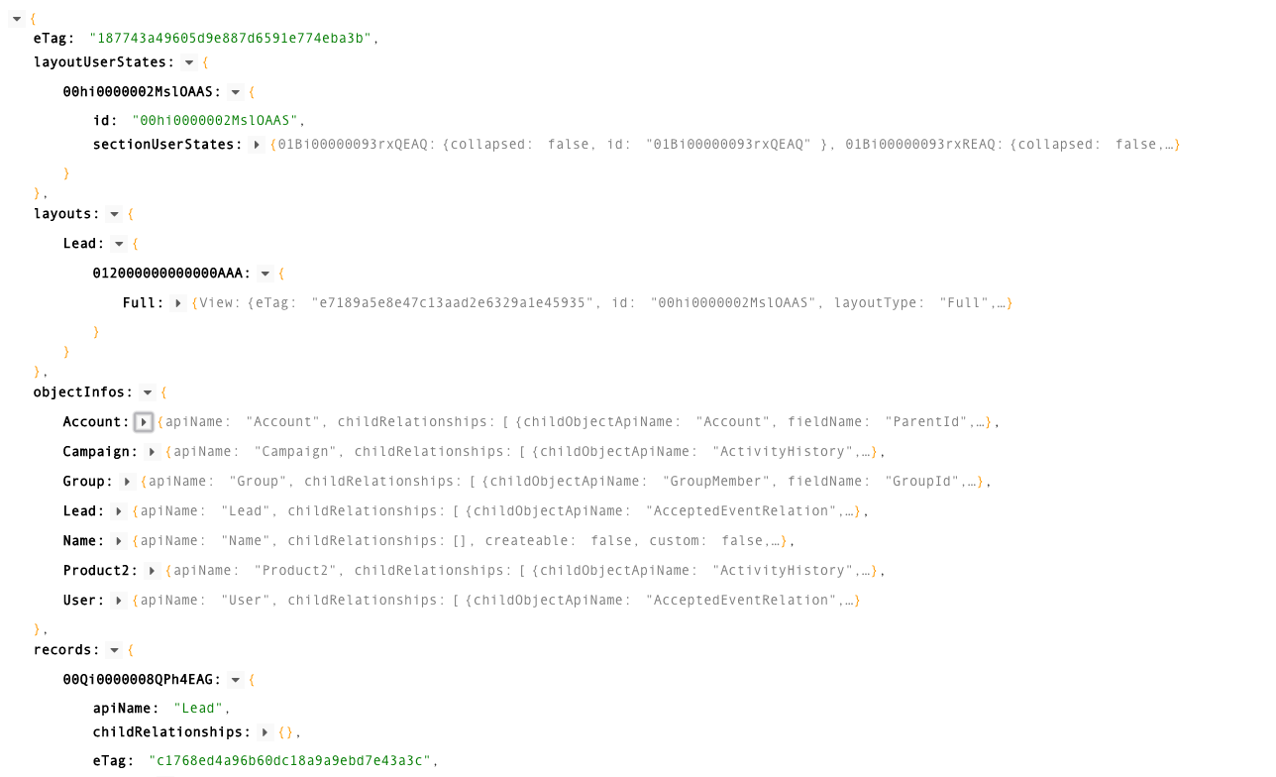

User Interface API
What is it?
A single API that returns both UI and record data

Slide 7
User Interface API
Tools to help you create custom UI easier
User Interface API
Respond to metadata changes, e.g. Layouts, Pick lists, FLS, Sharing, and other declarative functions
Lightning Data Service
Provide JavaScript API and caching for record CRUD in your Lightning component – without requiring APEX

Slide 8
User Interface API
Lightning Technology Stack

Slide 9
User Interface API
Benefits
Smart Payloads
metadata + data
Formatted and Localized Display Values
Field-Level Security and Sharing Rules
Business Logic
Layout Type and Form Factors
Access Modes

Slide 10

User Interface API
When not to use the API
System integration, e.g. data uploads or extraction
Building Lighting Components
Use force:recordData and other base components instead
Apps that don’t get updated
no support after 3 years (10 versions)

Slide 11

User Interface API
Endpoints
Records
Layouts and Object metadata
Create, Edit, View modes
Clone and default values
Picklists and dependent picklists
Child Relationships (Junction Lists)
Binary uploads (i.e. Files)

Slide 12

User Interface API
Endpoints
Actions
List of Actions with metadata
Navigation
Favorites
Search
Dependent Lookups

Slide 13
User Interface API
Demo!

Slide 14
Wrap up
Questions?

Slide 15

Trailhead
https://sforce.co/2OypIcz

Slide 16


